Slide 1

NP-COMPLETE AND NP-HARD
NP-complete problems: the most difficult problems in NP
if you can solve any one of the NP-complete problems in polynomial time, then you can solve every problem in NP in polynomial time
because algorithm for NP-complete problem can be used to solve any other problem in NP, after suitable preprocessing (reduction)

Slide 2
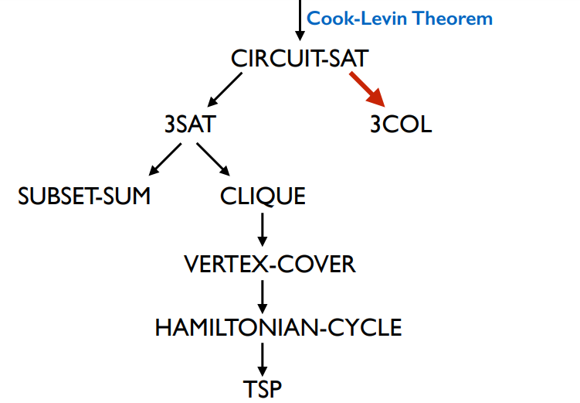

Slide 3




Slide 4

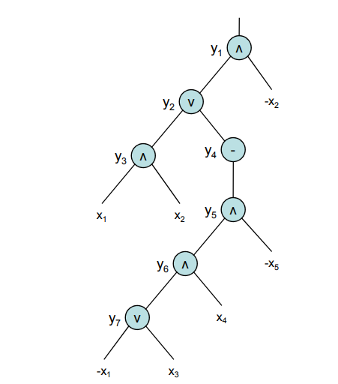

Slide 5
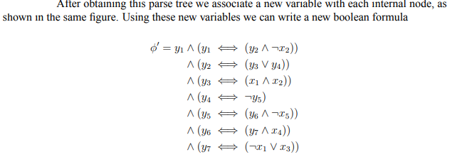
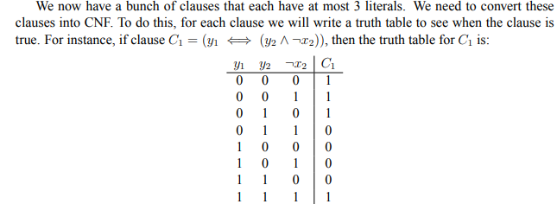

Slide 6
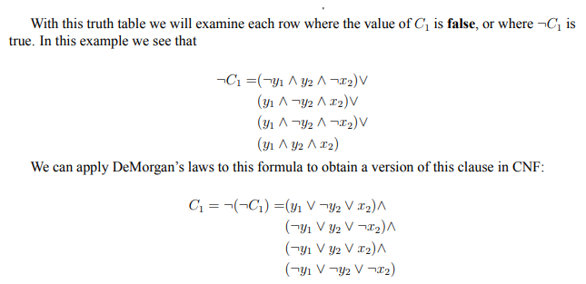
Thus we can show that SAT _{P} 3SAT

Slide 7
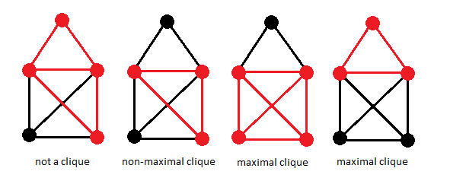
CLIQUE
A Clique is a subgraph of graph such that all vertcies in subgraph are completely connected with each other.
EXAMPLES

Slide 8
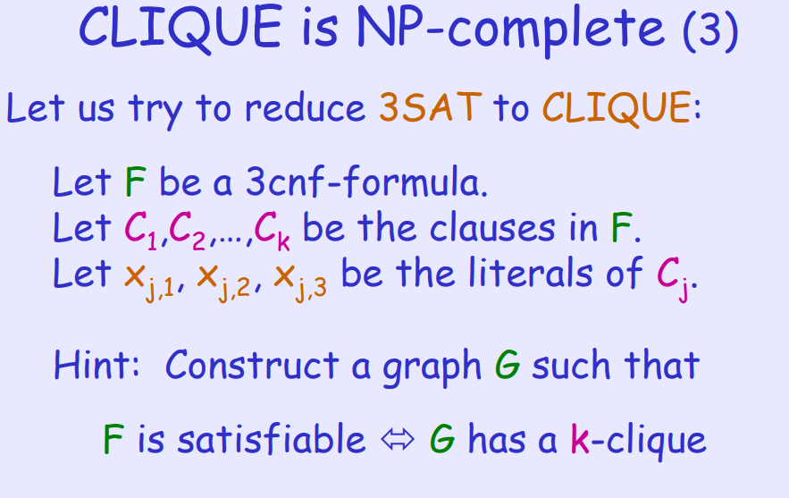

Slide 9
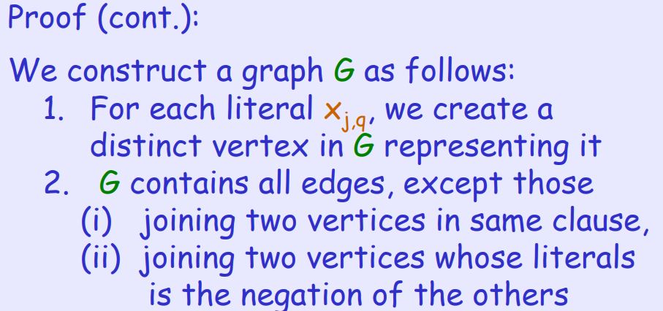

Slide 10
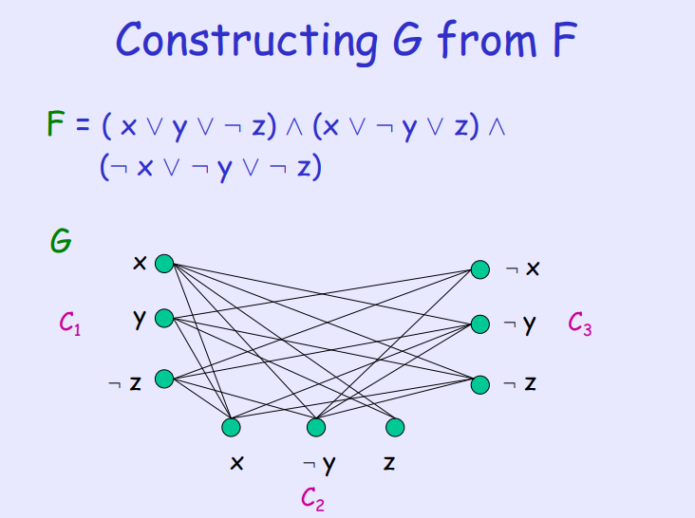

Slide 11
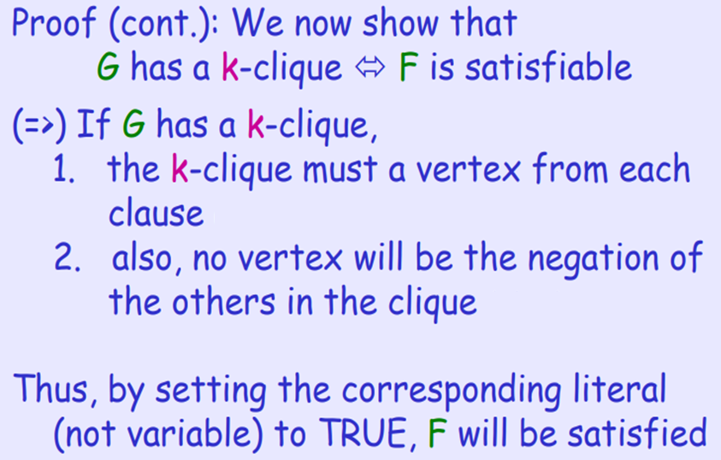

Slide 12
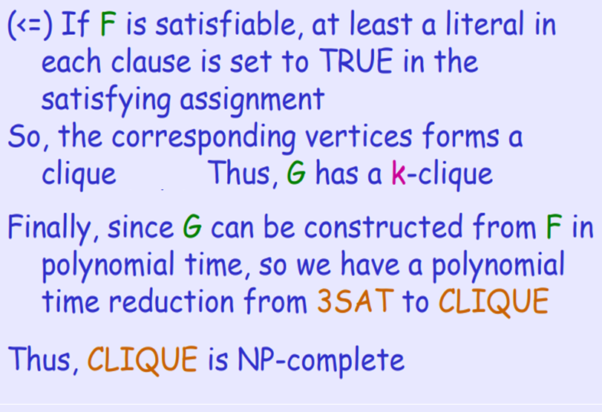

Slide 13


Slide 14
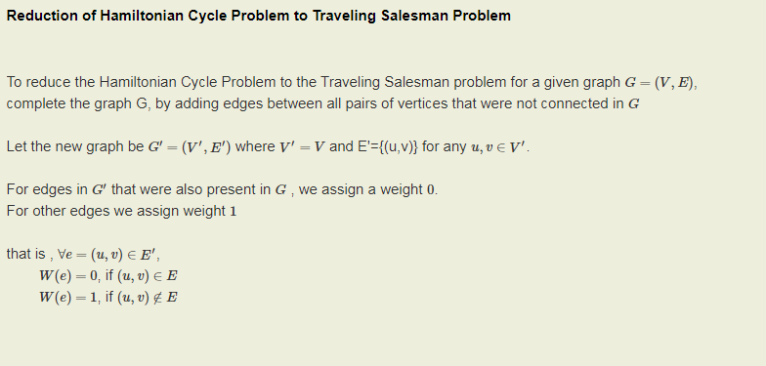

Slide 15
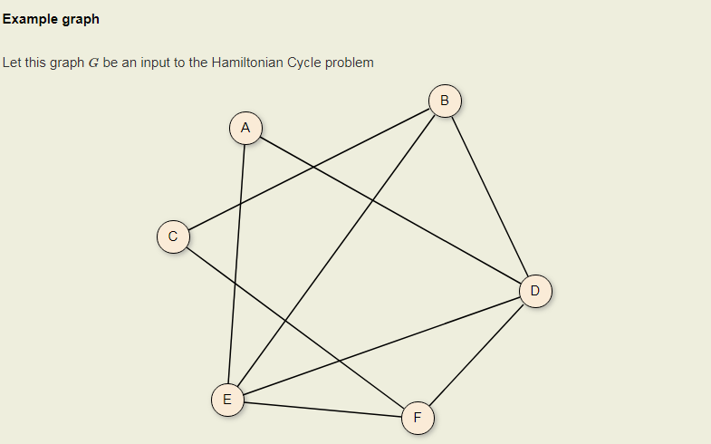

Slide 16
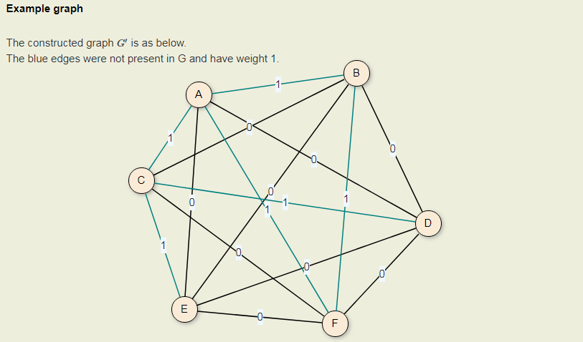

Slide 17
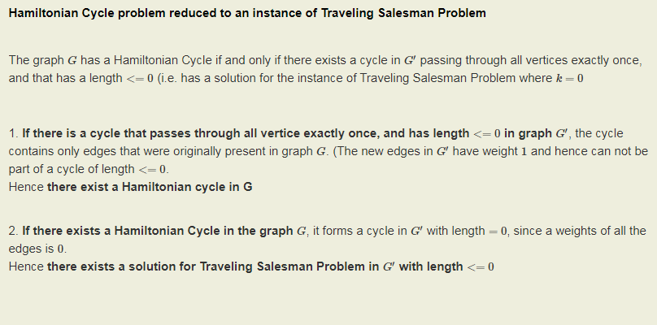

Slide 18
